Slide 1
Practically Teaching
Training the Next Generation of Instruction Librarians Through an LIS Practicum Experience
Jenny Dale, UNC Greensboro

Slide 2
Think-Pair-Share!
What types of teaching do you do?

Slide 3
One more time!
How did you learn how to teach?

Slide 4
From the Literature

Slide 5
Emporia State University
“...theoretical knowledge and practical expertise in library instruction and information literacy may be difficult for a[n LIS] student to obtain” (Kane & Meehlhause, 2014, p. 13).

Slide 6
Emporia State University
New initiative in 2011 to hire LIS students as Graduate Teaching Assistants for 20 hours per week
About 10 hours devoted to teaching
Freshman comp and other gen ed IL instruction
Contributions to UL100, 2-credit course called “Information Literacy and Technology”
(Kane & Meehlhause, 2014)

Slide 7
Emporia State University
Supervision
Training prior to the start of the first semester of the assistantship, including reference desk observation and introduction to the Libraries’ IL curriculum
GTAs were regularly observed
Teaching observations were supplemented by post-teaching surveys
The assistantships are mutually beneficial
(Kane & Meehlhause, 2014)

Slide 8
George Washington University
120-hour instruction internship/practicum
Five interns who completed the internship between 2003 and 2008 responded to a questionnaire about their experiences
All respondents found the actual teaching experience most useful to them
(Nutefall, 2012)

Slide 9
George Washington University
Recommendations:
Write a job description.
Conduct interviews.
Provide an authentic experience.
Plan projects.
Provide continual feedback through multiple means.
Develop relationships with the LIS program
Publicize the internship opportunity.
(Nutefall, 2012, p. 89-90)

Slide 10
George Washington University
Recommendations:
Write a job description.
Conduct interviews.
Provide an authentic experience.
Plan projects.
Provide continual feedback through multiple means.
Develop relationships with the LIS program
Publicize the internship opportunity.
(Nutefall, 2012, p. 89-90)

Slide 11
George Washington University
Recommendations:
Write a job description.
Conduct interviews.
Provide an authentic experience.
Plan projects.
Provide continual feedback through multiple means.
Develop relationships with the LIS program
Publicize the internship opportunity.
(Nutefall, 2012, p. 89-90)

Slide 12
George Washington University
Recommendations:
Write a job description.
Conduct interviews.
Provide an authentic experience.
Plan projects.
Provide continual feedback through multiple means.
Develop relationships with the LIS program
Publicize the internship opportunity.
(Nutefall, 2012, p. 89-90)

Slide 13
Northwestern University, Schaffner Library
Revamped pre-professional intern program based on Peter Drucker’s Management Challenges for the 21st Century
Shift from “Here is how you do the task” to a more holistic “What is the task?” (Doyle, 2008, p. 397).
Blog for interns and staff to share reference experiences
Increased one-on-one time with intern supervisor

Slide 14
UNCG Libraries: First-Year Instruction Practicum

Slide 15
The basics
120 hours
15 hours of observation
70 hours of teaching
15 hours of reflection
20 hours professional development

Slide 16
The theory behind the practice
“...learning, change, and growth are best facilitated by an integrated process that begins with 1) here-and-now experience followed by 2) collection of data and observations about that experience. The data are then 3) analysed and the conclusions of this analysis are feedback to the actors in the experience for their use in the 4) modification of their behavior and choice of new experiences” (Kolb & Fry, 1975, p.33-34).

Slide 17
OR!
Concrete experience
Testing implications Observations and
of concepts in new reflections
situations
Formation of abstract
concepts and generalizations
(Kolb & Fry, 1975, p. 33)

Slide 18
But...
We really start somewhere out here with observation of experienced practitioners.
Concrete experience
Testing implications Observations and
of concepts in new reflections
situations
Formation of abstract
concepts and generalizations
(Kolb & Fry, 1975, p. 33)

Slide 19
Concrete experiences
All First-Year Instruction Practicum students:
Team-teach first-year and upper-level information literacy sessions
Teach first-year information literacy sessions
Many students also:
Develop assessment instruments
Create online learning objects

Slide 20
Observations and reflections
All practicum students must create a space for reflection (blog, tumblr, etc.)
Weekly posts are required
Some specific reflection assignments from me, but typically free-form
These observations and reflections lead to Kolb & Fry’s “Formation of abstract concepts and generalizations”

Slide 21
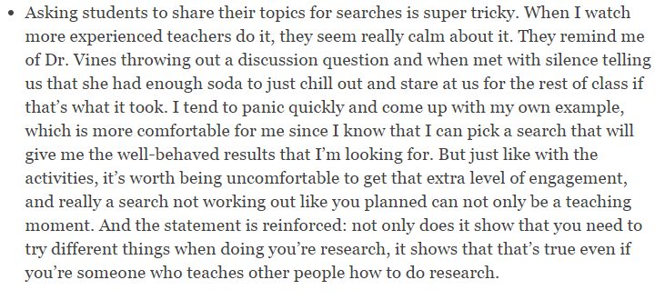
Getting comfortable with discomfort

Slide 22
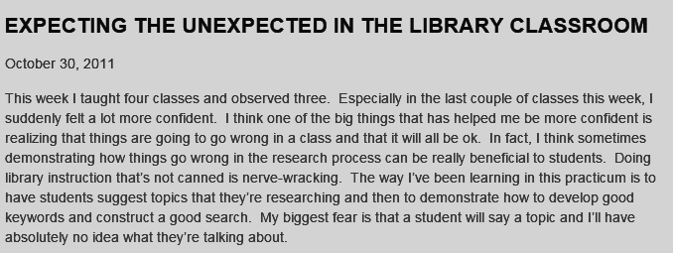
Failure is an option

Slide 23
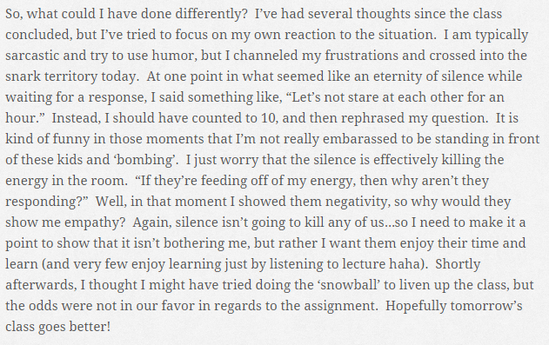
This is the sound of silence

Slide 24
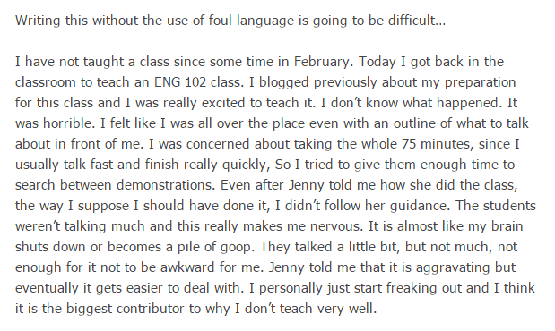
The struggle is real

Slide 25
Everyone's a (self) critic

Slide 26
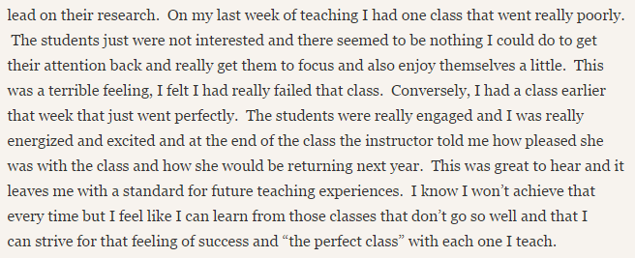
Taking the good with the bad

Slide 27
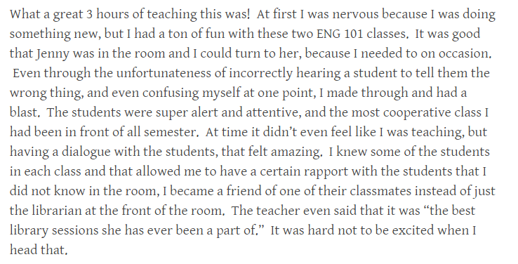
I woke up like this

Slide 28
Testing implications
Good reflection results in action
Blogs and regular observation and feedback from me facilitate the experiential learning cycle

Slide 29
The teacher becomes the student
One size does not fit all
Feedback should be specific, timely, and (whenever possible) face-to-face
Schedule regular check-ins
Develop a list of concrete projects to avoid busy work to fill remaining hours
Empowering practicum students to make game-time decisions increases their confidence

Slide 30
Thank you!
Please feel free to contact me at:
jedale2@uncg.edu

Slide 31
References
Brecher, D., & Klipfel, K. M. (2014). Education training for instruction librarians: A shared perspective. Communications in Information Literacy, 8(1), 43–49.
Doyle, C. (2008). Rethinking preprofessional training to improve work quality: Engaging library interns. College & Research Libraries News, 69(7), 396–426.
Kane, C., Meehlhause, K., & Ryan, M. (2014). GTA = Great Teaching Adventure! Reference & User Services Quarterly, 54(1), 12–16.
Kolb, D. A., & Fry, R. E. (1975). Toward an applied theory of experiential learning. In C.L. Cooper (Ed.), Theories of group processes. London: Wiley & Sons.
Nutefall, J. E. .(2012). Structuring a successful instruction internship. College & Undergraduate Libraries, 19(1), 80–94. http://doi.org/10.1080/10691316.2012.652550

